Slide 1
3D Print Montreal
Daniel Levitin & Valentin Atanasov

Slide 2
TABLE OF CONTENTS
01
02
03
04
05
06
ERD
About our service
Our target audience
Program Flow
Main Pages
Core Features

Slide 3
01
Our goal is to provide a service for Montréalers who either wish to print their own 3d models on occasion or who do not have access to a printer or the means to acquire one.
Our clients will be charged depending on the time and resources their model takes to print.
We will also offer the opportunity for their model to be shipped if they cannot retrieve it themselves from one of our retrieval location.

Slide 4
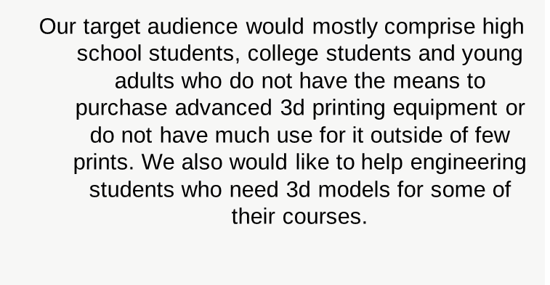
02

Slide 5

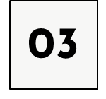
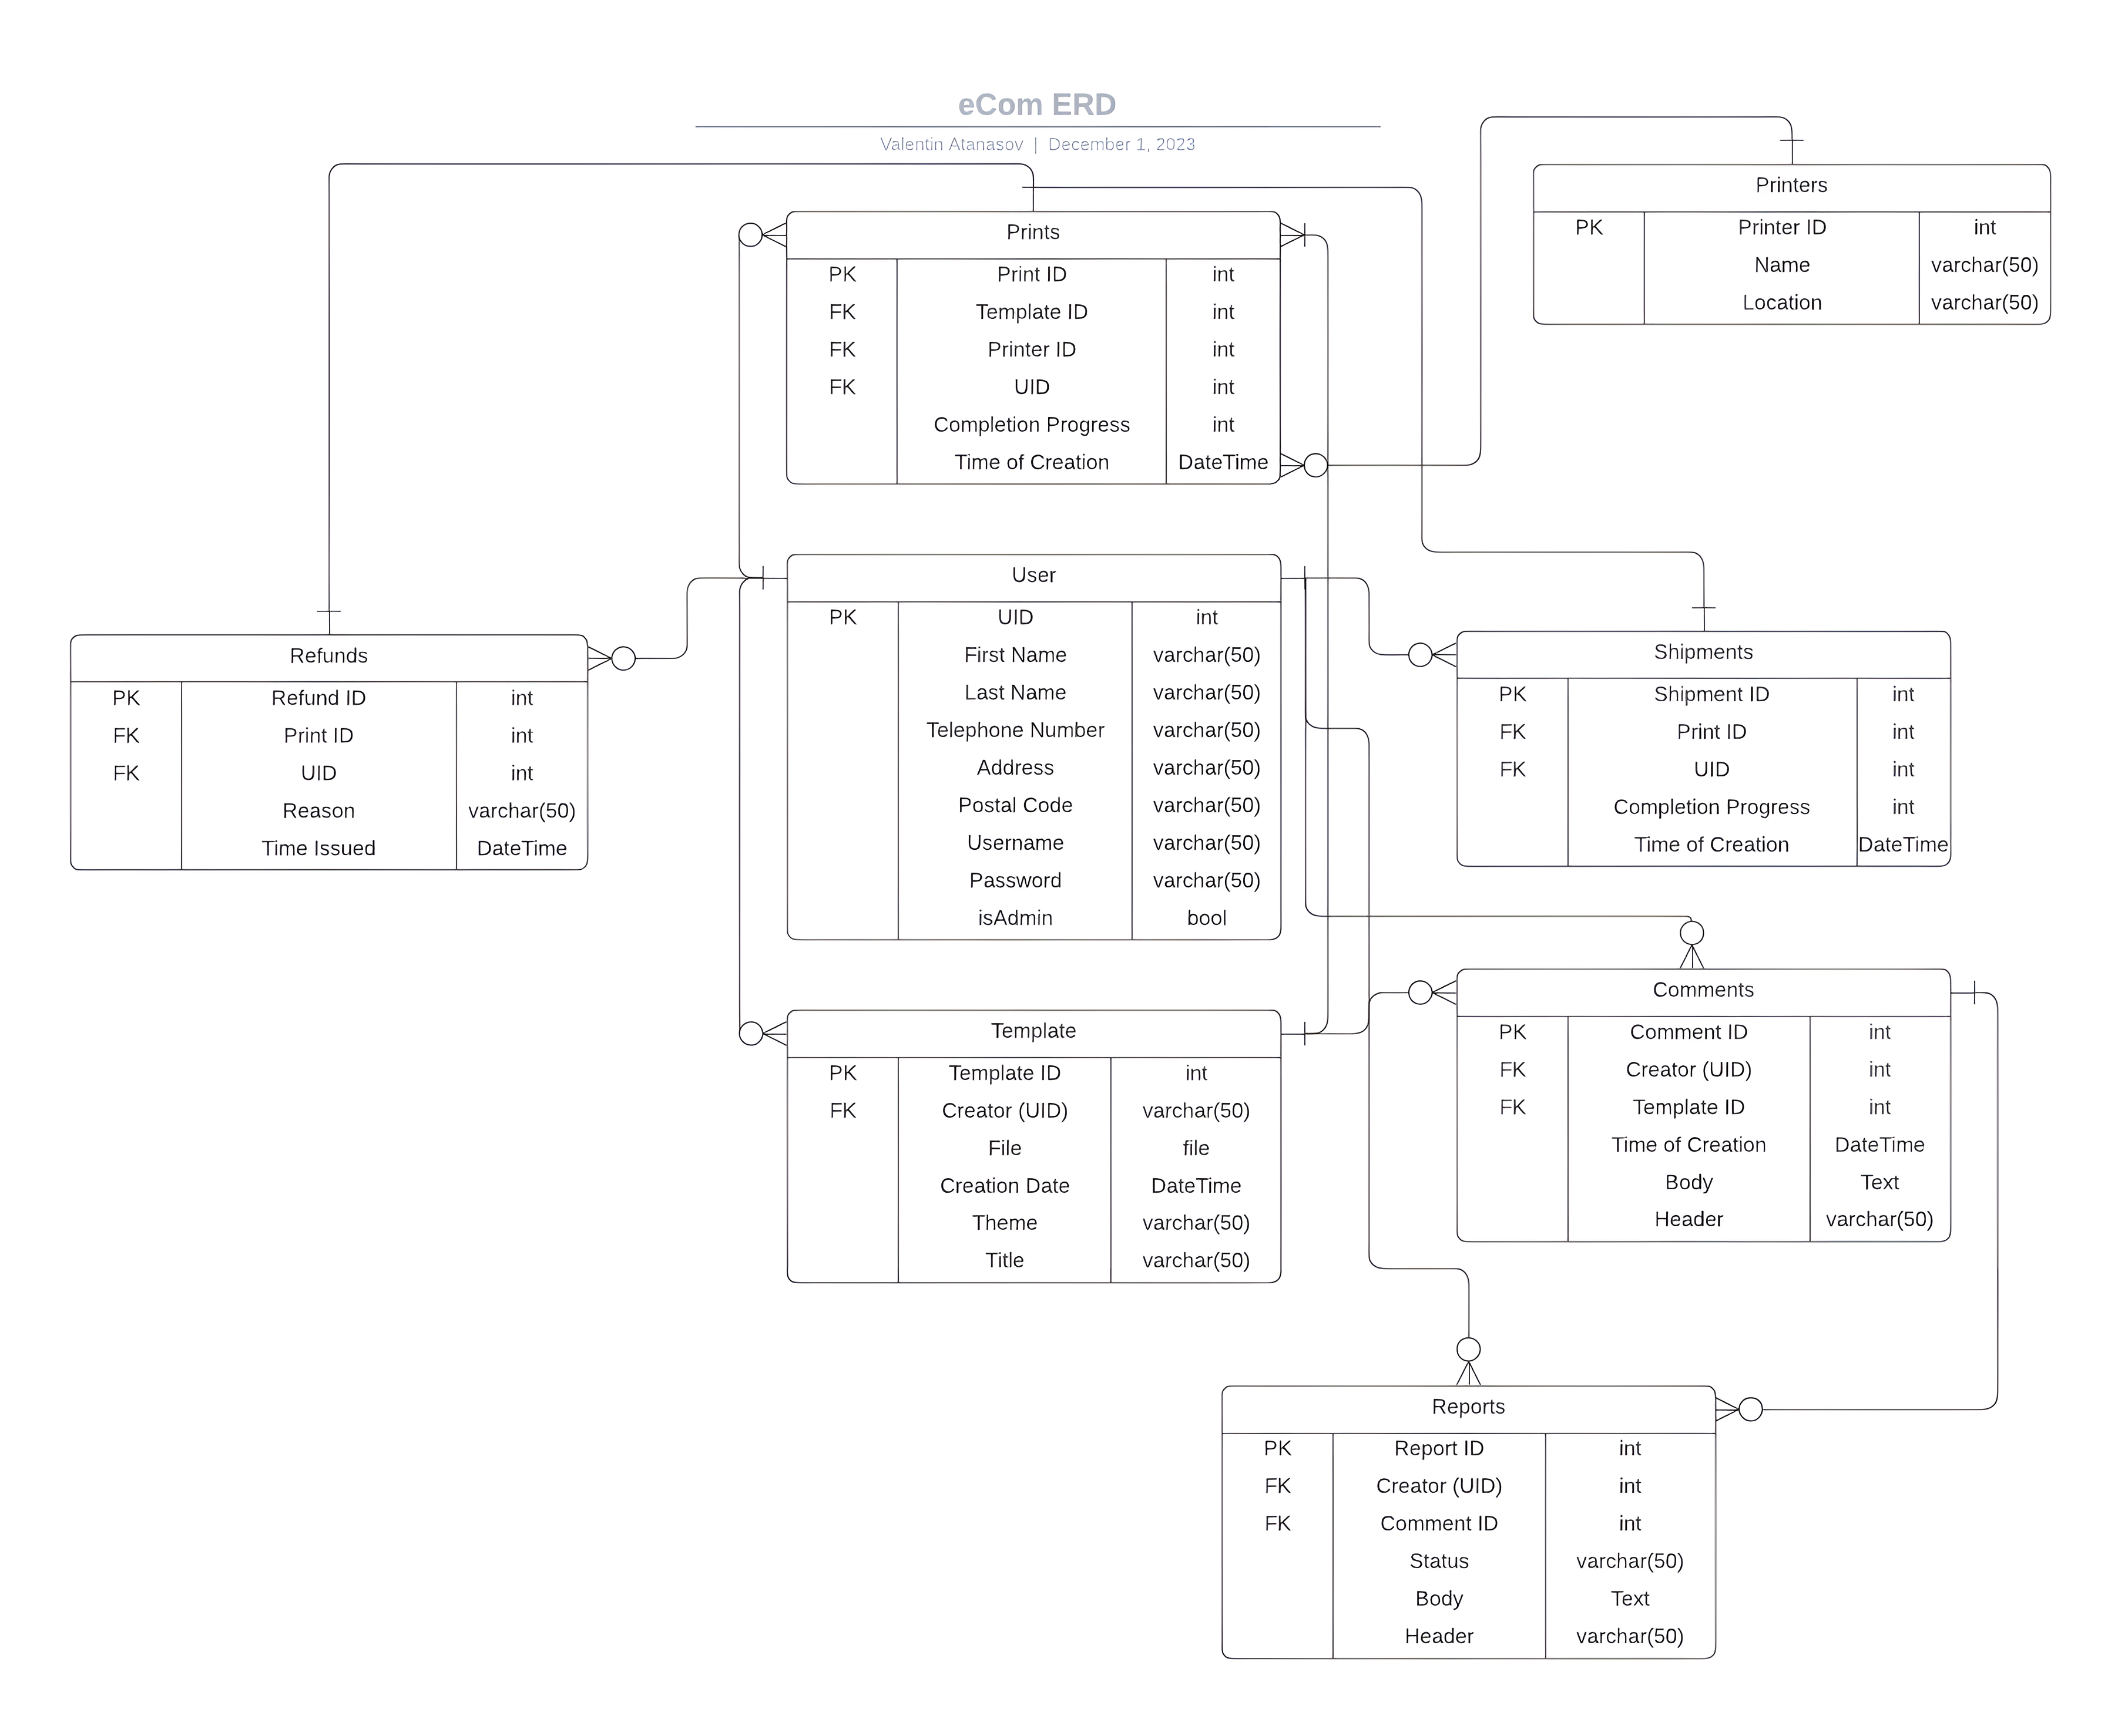
ERD
Important Details
Most of our tables revolve around the ‘Users’ table since many of our elements cannot exists without being attached to a user.
Most tables have 2 foreign keys as they need to be associated with multiple other tables.

Slide 7
04
Program Flow

Slide 8
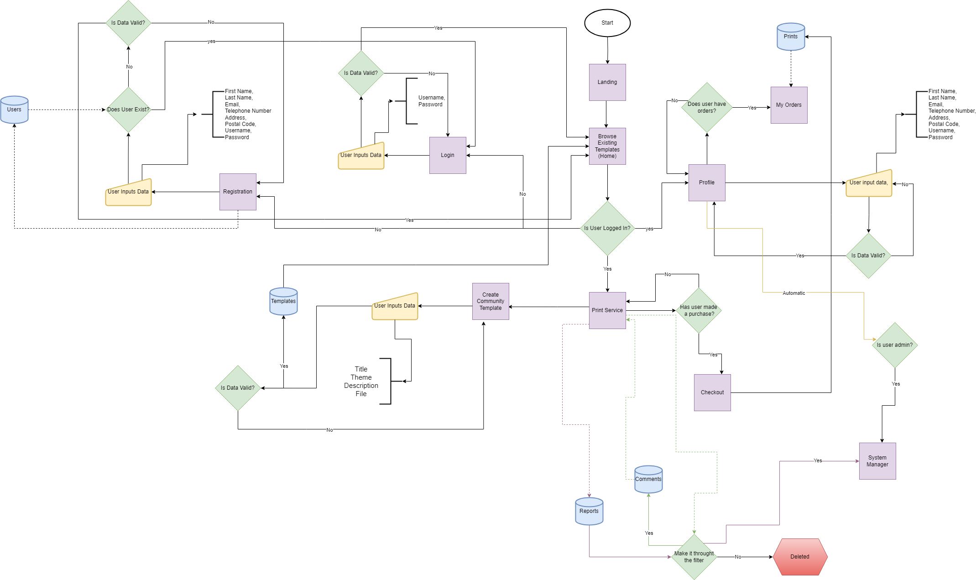
Important Details
3 Main Modules; User Logic, Print/Order Management, Management Logic
Upon login, user is automatically checked by system for admin rights.
All reports and comments pass through a basic filter that verifies for gibberish or profanity.

Slide 10
05
Main Pages

Slide 11
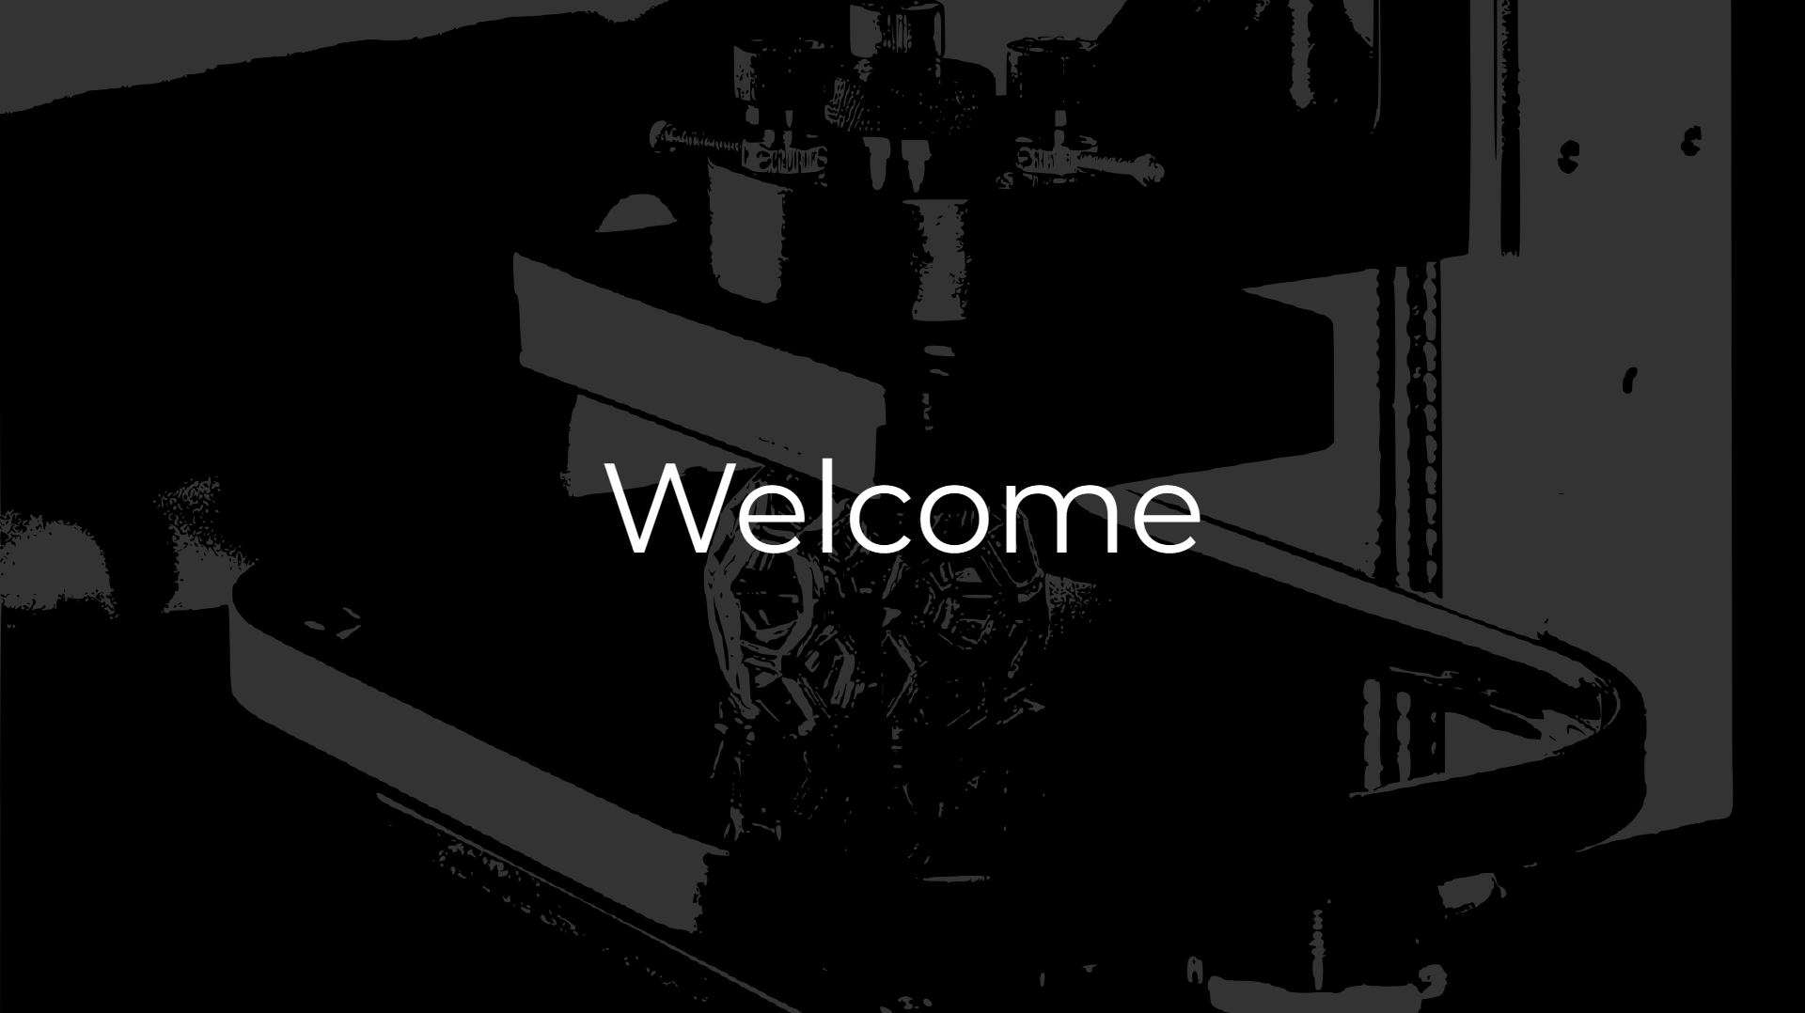
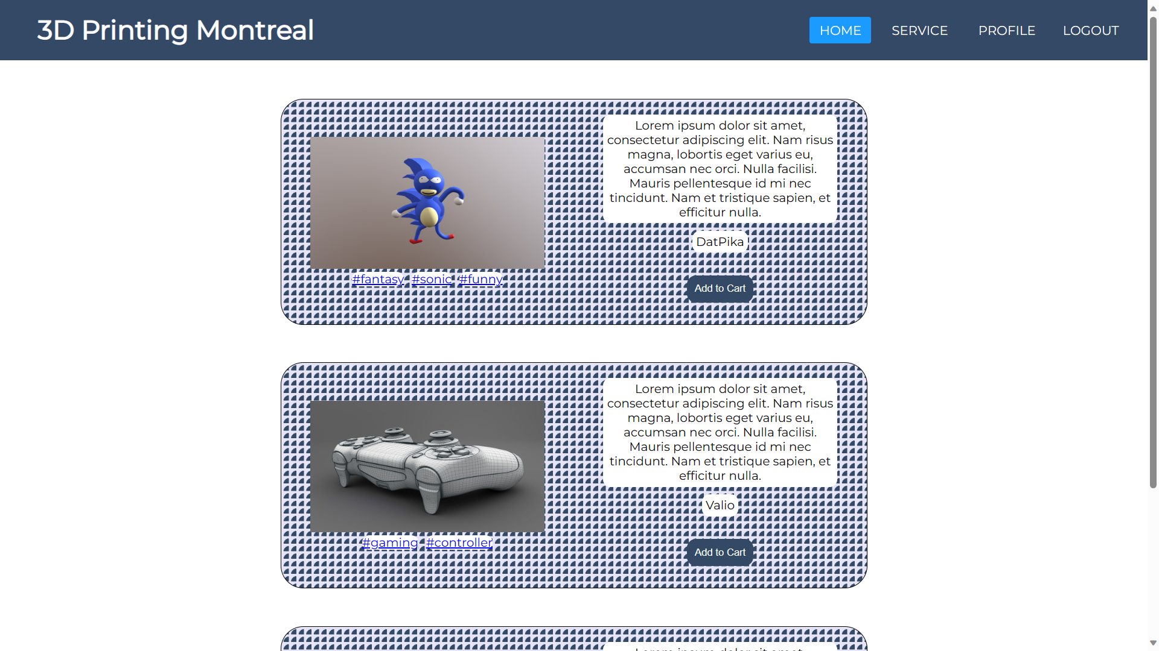
Home
The home page is a centerspace where users can browse templates of different kinds and from different users.

Slide 12
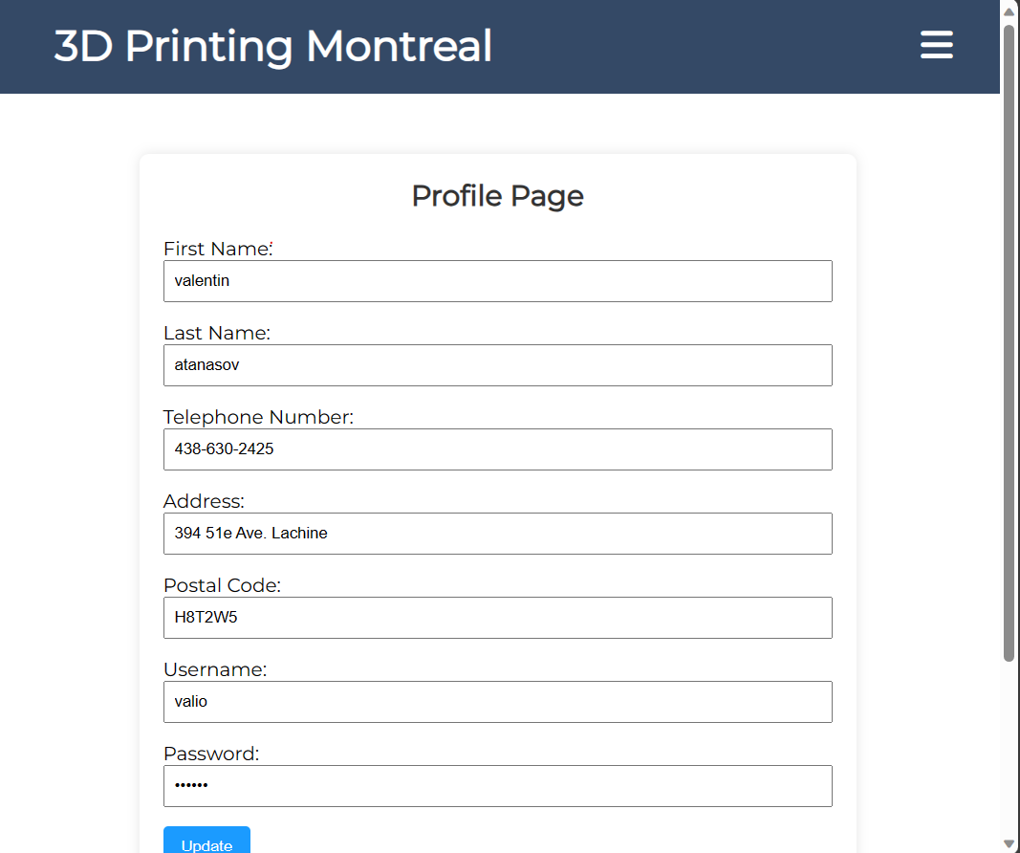
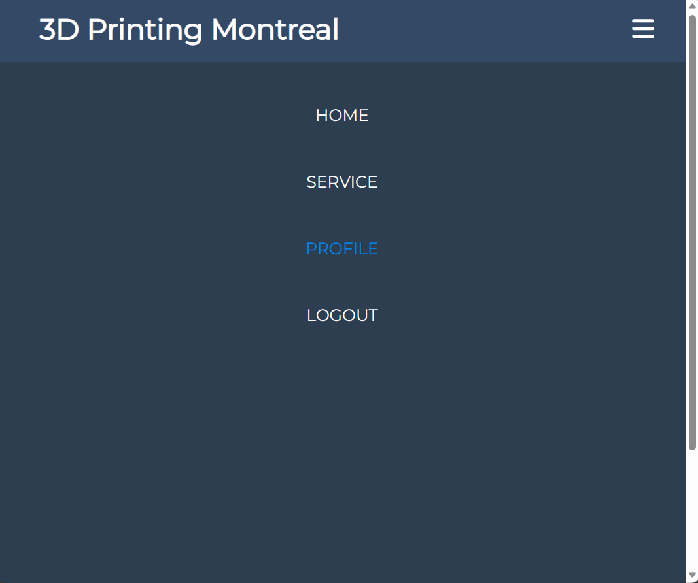
Home-Display
The navigation bar changes dynamically

Slide 13
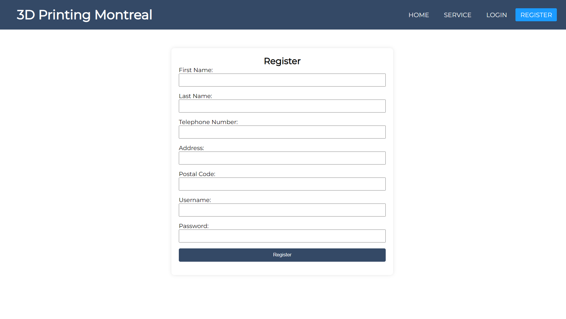
Register
Registering as a new user

Slide 14
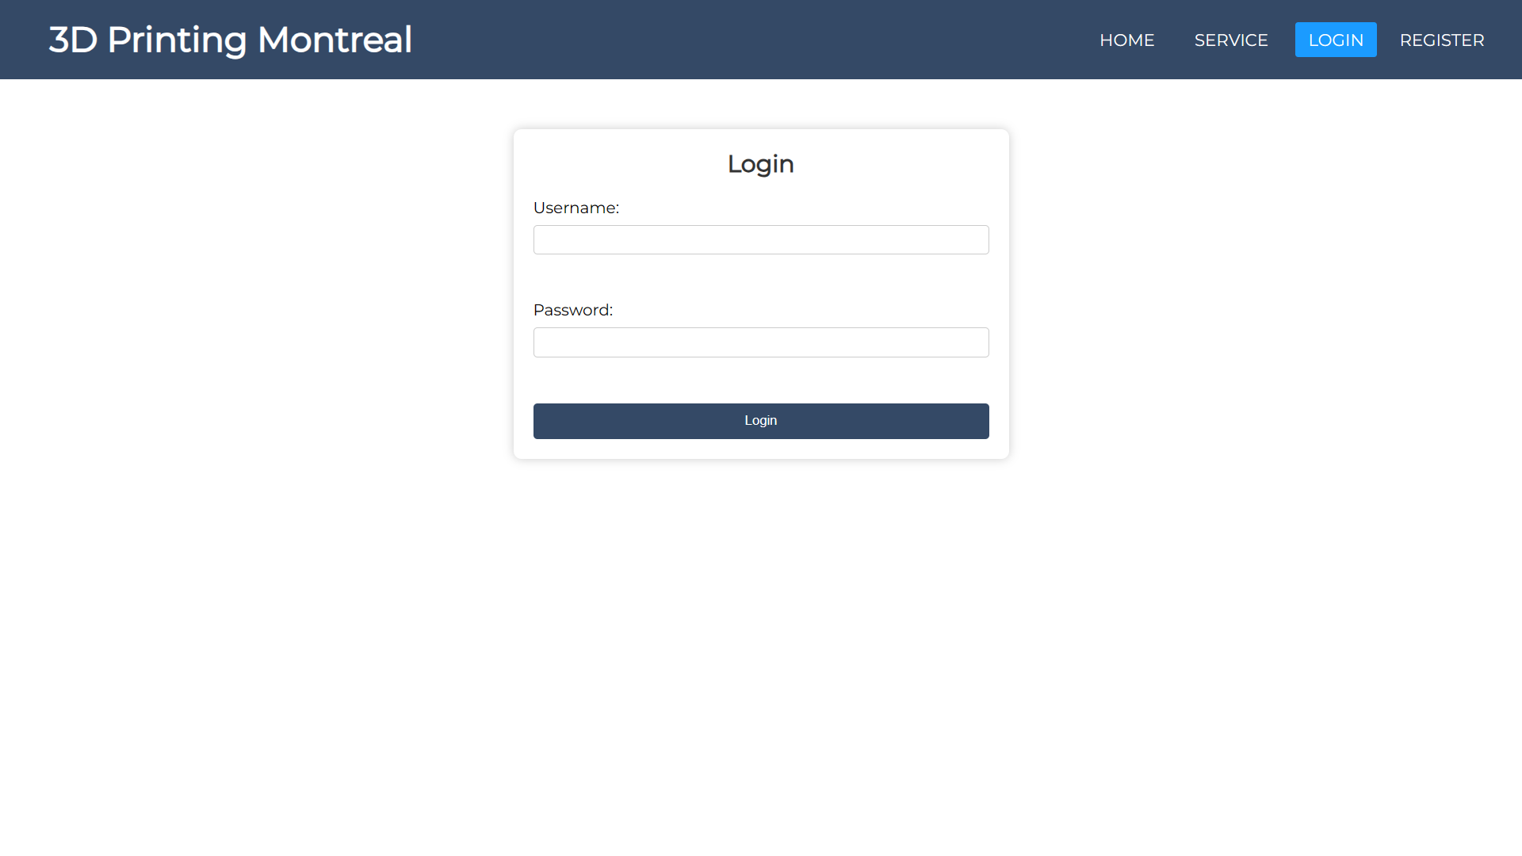
Login
Logging in as an existing user

Slide 15
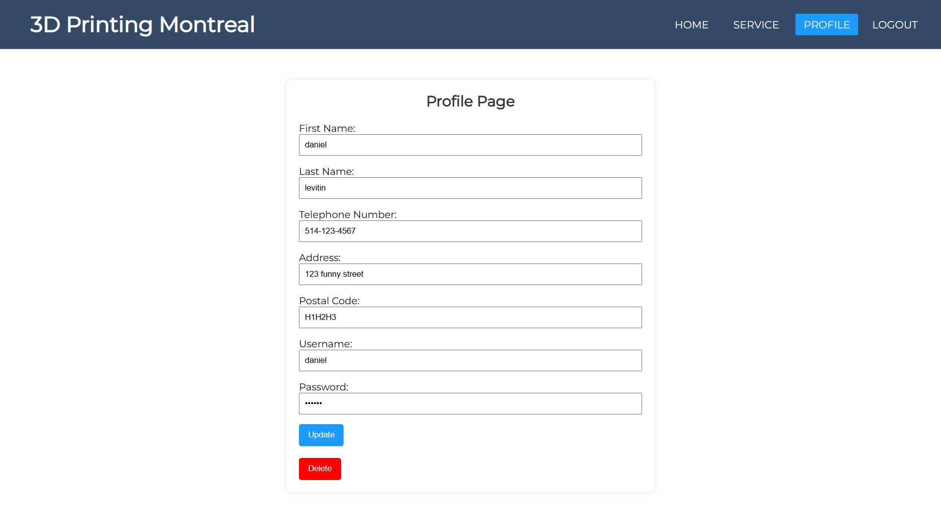
Profile
Users can view information about their account, along with their previous orders/prints

Slide 16
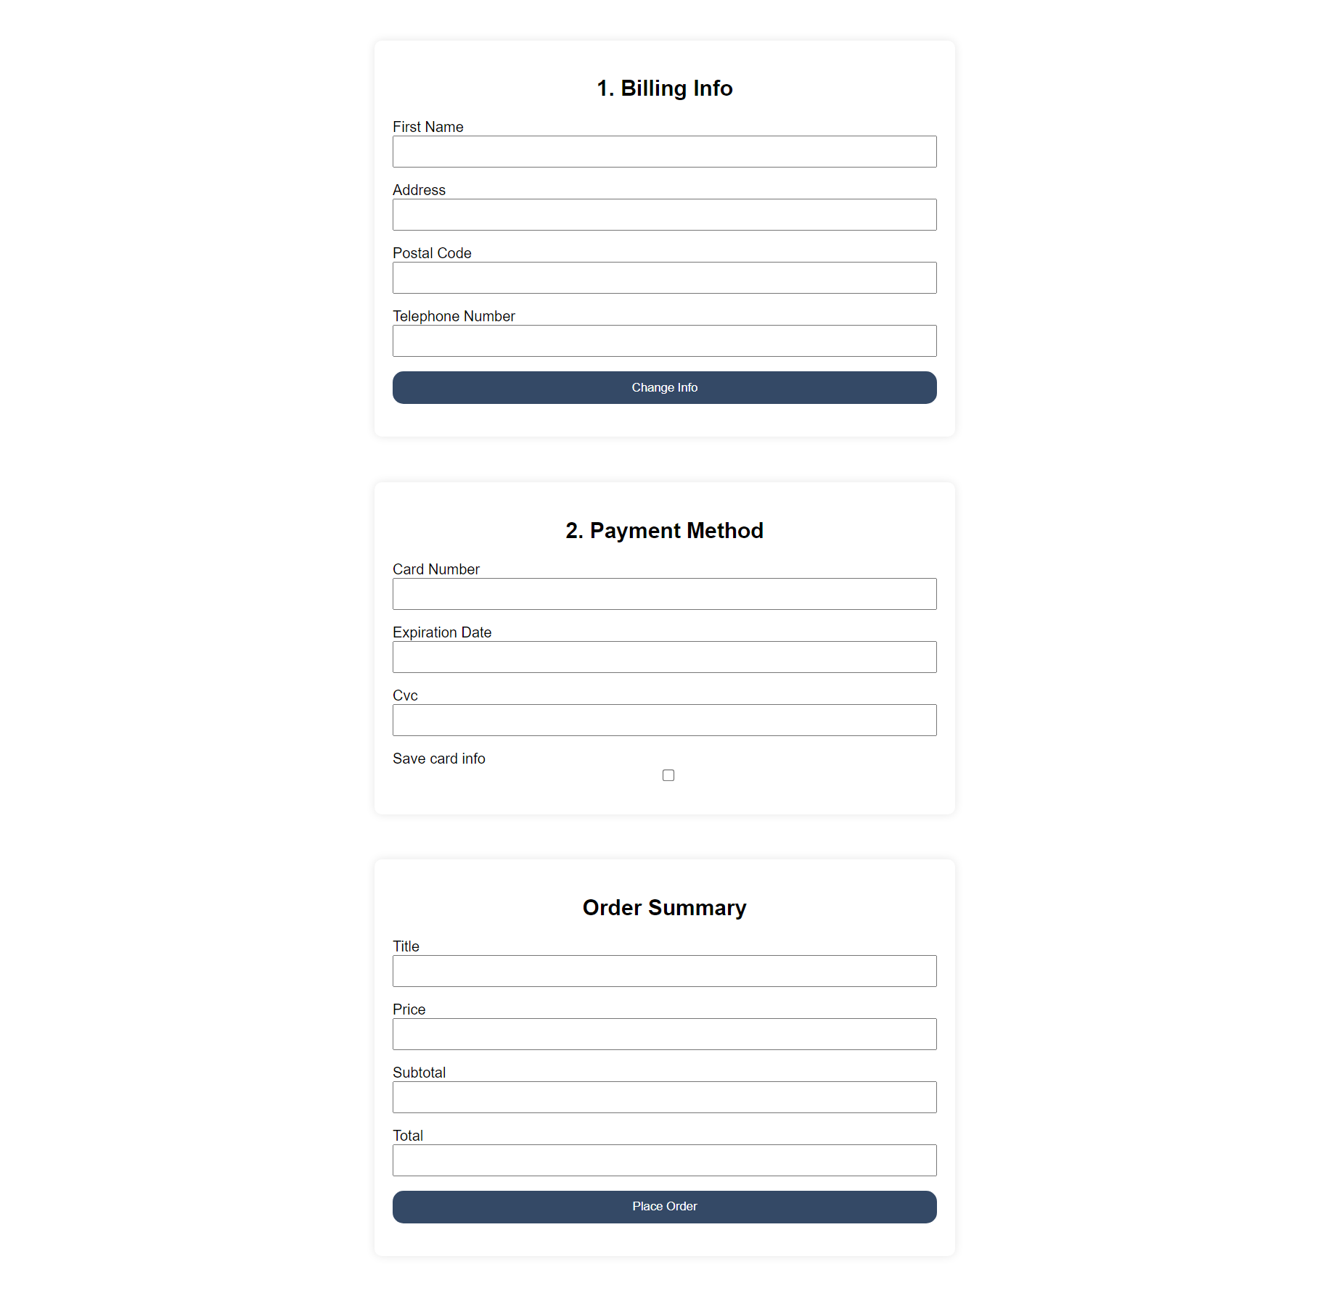
Checkout
When requesting a print, users get redirected to a checkout page to confirm their order.

Slide 17
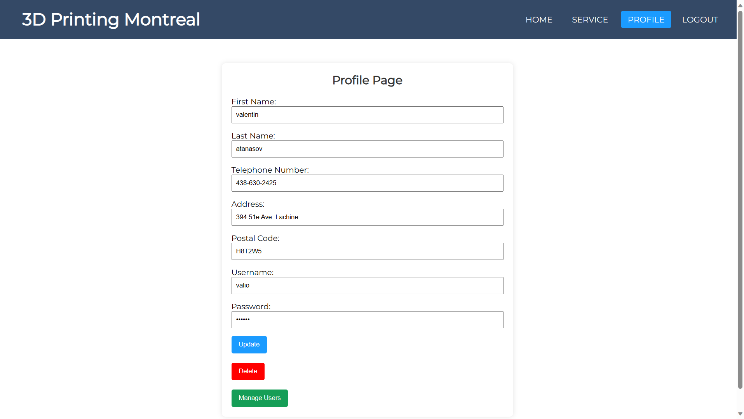
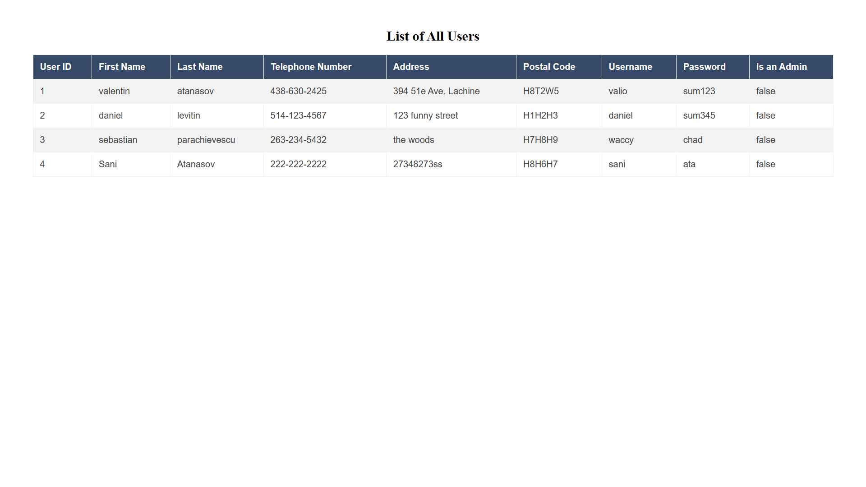
Managing System
Admin users get an extra option to manage the system from their profile.

Slide 18
06
Core Features

Slide 19
MODULES
ORDER/PRINT
MANAGEMENT
USER
Add to cart
Edit billing info
Place order
Users
Prints
Reports
Printers (online/offline)
Register
Login
Logout
Profile

Slide 20
Thank you!
Questions?

